Slide 1



FITNESS CENTER
BI System - ITI Graduation Project

Slide 2







OUR TEAM
Mohamed Ghazal
Maryam Salah
Ahmed Khaled
Sherif Khaled
Mohammad Anwar
Youssef Radwan

Slide 3



TABLE OF CONTENT
Project Overview
Project Workflow
Tools & Technologies
ERD & Mapping
Database Tables
Database Creation
Database T-SQL
RFM Analysis
SSRS stored Procedures
SSRS Reports
Power BI Dashboards
Website UI & Function

Slide 4

PROJECT OVERVIEW
Problem:
Fitness centers deal with large amounts of scattered data related to members, attendance, branches, and performance.
This lack of organization makes it difficult to track trends, measure results, and make informed decisions.
Solution:
The project provides an end to end BI solution that organizes all operational data in one structured place.

Slide 5


PROJECT WORKFLOW
System Analysis
ERD
Mapping
Database Design
Data Modelling
Database Users
Transact SQL
Data Generation
Dashboards Creation
Dashboards Design
SSRS Reports
Website Creation

Slide 6










TOOLS & TECHNOLOGIES
Power BI

Slide 7
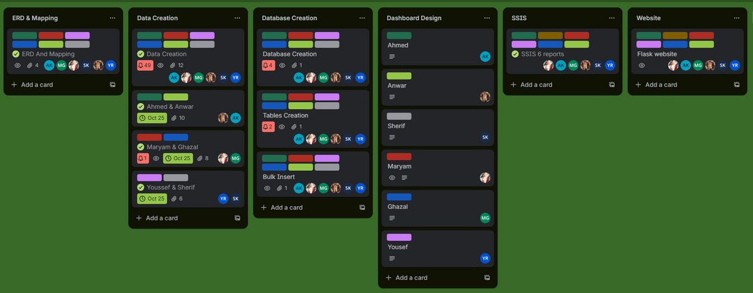
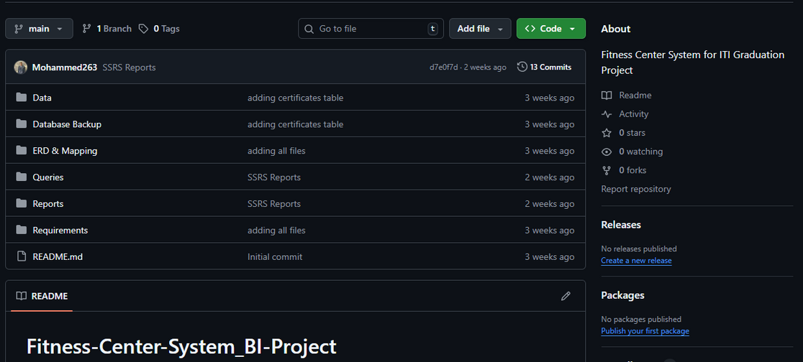
Collaboration & Source Control
Trello
GitHub

Slide 8
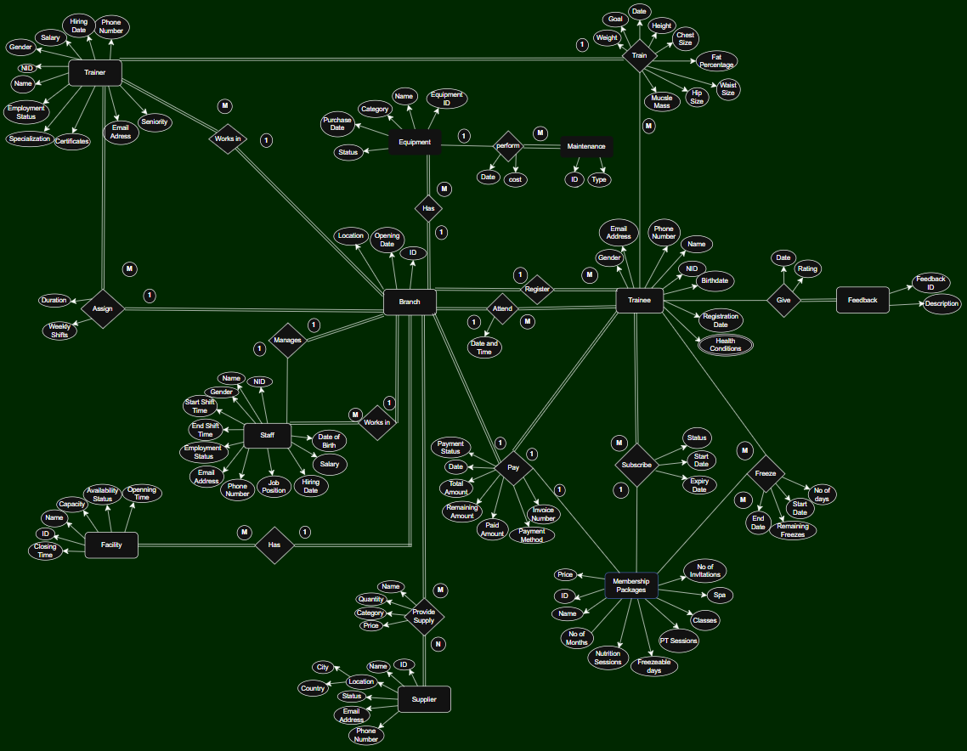
ERD
Entities: 10
RelationShips: 15

Slide 9
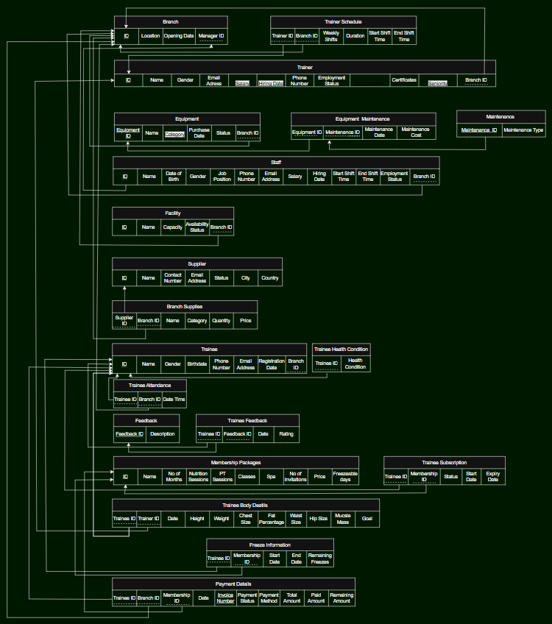
MAPPING
Tables: 20
Satisfies the Third Normal Form

Slide 10


DATABASE TABLES
Branch
Equipment
Equipment Maintenance
Facility
Feedback
Freeze
Maintenance
Membership Packages
Payment Details
Staff
Supplier
Supplies
Trainee
Trainee Attendance
Trainee Body Details
Trainee Feedback
Trainee Health conditions
Trainee Subscription
Trainer
Trainer Certificates
Trainer Schedule

Slide 11

DATABASE CREATION
we created our database in three phases
01
Creating Constraints, Rules and Indexes to assure validation
Generating data using AI, Testing the data, Then inserting the data
02
Program the database via stored procedures, Triggers and defaults
03

Slide 12
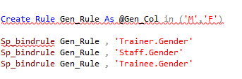
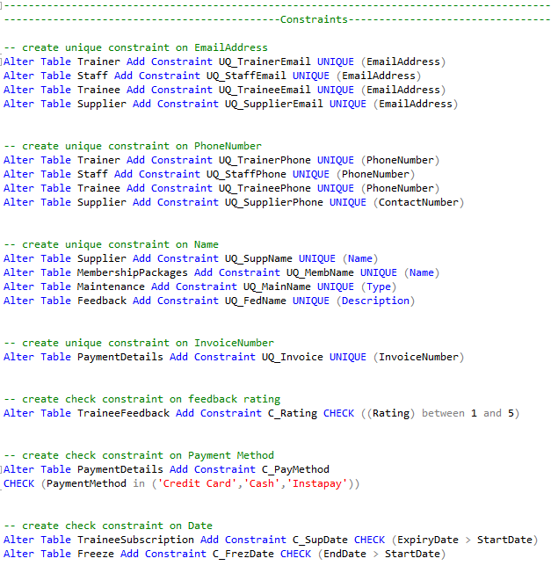
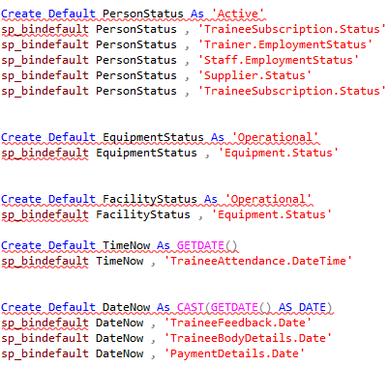
Constraints & Rules & Defaults
CONSTRAINTS
RULES
DEFAULTS

Slide 13

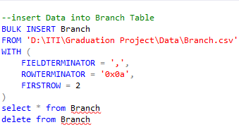
Generating & Inserting Data
BULK INSERT
Generated Data via AI (Chat GPT, Gemini) by adjusting the appropriate prompts to generate tables
Ensured Data validation using Excel to check the cleanness of the data and data types Compatibility
Inserted data into the database using Bulk Insert in SQL Server

Slide 14

INDEXES
Created a non Clustered Index to on the trainee phone number to to improve and speed up the search process based on that field

Slide 15
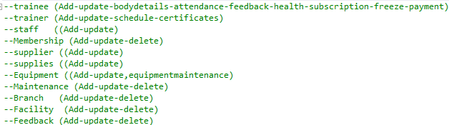
STORED PROCEDURES
Created stored procedures to handle all CRUD operations (Create, Read, Update, Delete).
This helps reduce repetitive code, improve performance, and ensure data is managed securely and consistently.

Slide 16
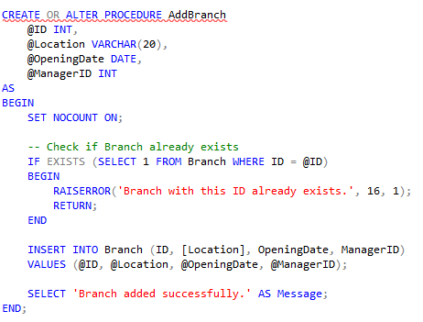
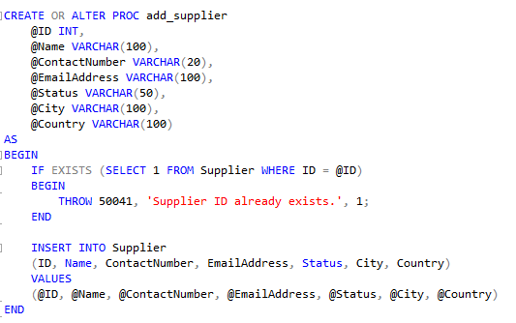
Stored Procedures for Adding
ADD BRANCH
ADD SUPPLIER

Slide 17
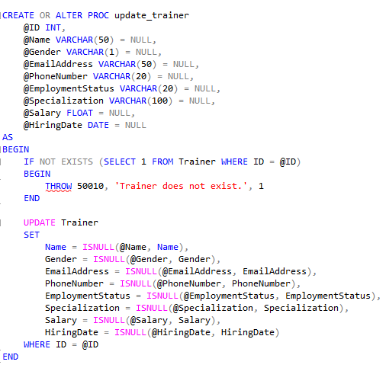
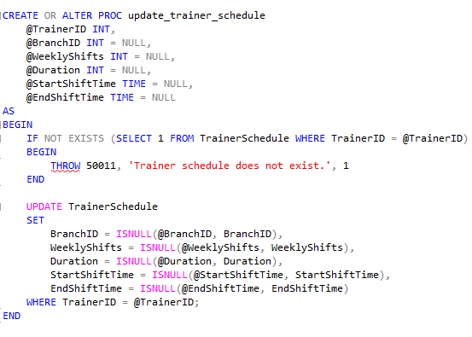
Stored Procedures for Updating
UPDATE TRAINER
UPDATE TRAINER SCHEDULE

Slide 18
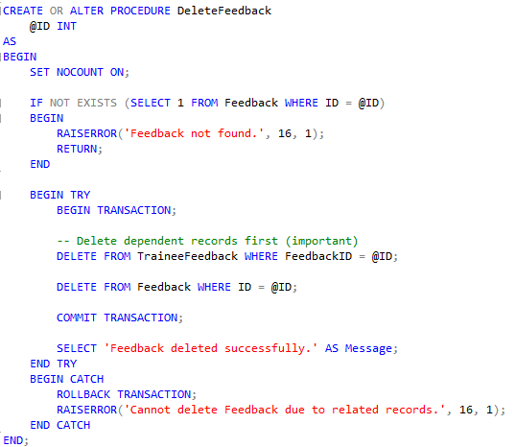
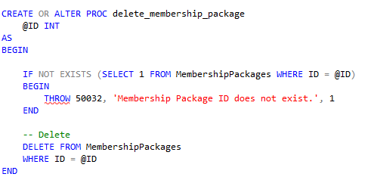
Stored Procedures for Deleting
DELETE PACKAGE
DELETE FEEDBACK

Slide 19
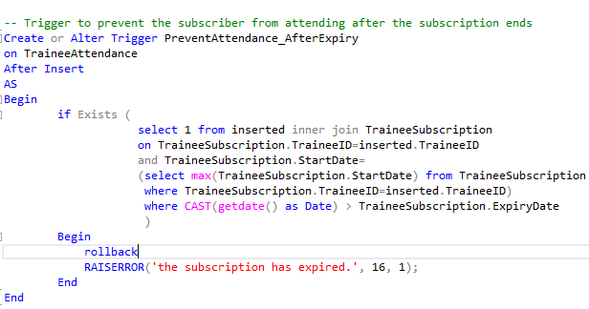
Triggers
1. PreventAttendance_AfterExpiry
Table: TraineeAttendance
Fires: AFTER INSERT
Purpose:
Prevents a trainee from logging attendance after their subscription has expired.
If someone tries to attend on a date later than their subscription expiry, the trigger rolls back the insert and shows an error.

Slide 20
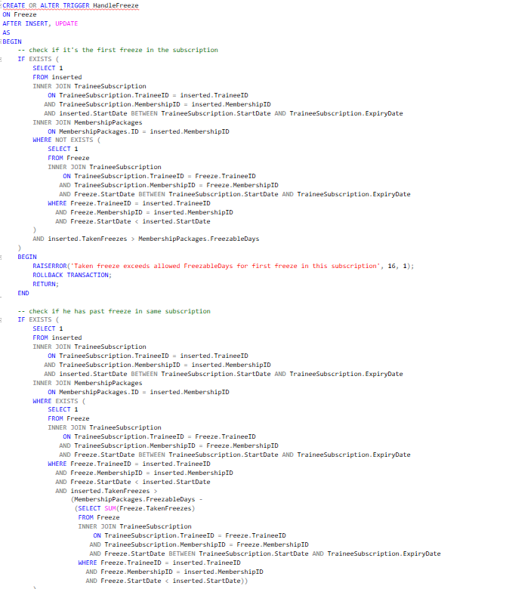
Triggers
2. HandleFreeze
Table: Freeze
Fires: AFTER INSERT, UPDATE
Purpose:
It handles all freeze logic for subscriptions:
It performs 3 main functions:
1.Validates first freeze: Prevents a trainee from taking more freeze days than allowed on the first freeze in a subscription.
2.Validates remaining freezes: If the trainee already used some freeze days, the trigger ensures the newly inserted freeze does not exceed the remaining allowed freeze days.
3.Updates freeze and subscription data automatically: Calculates and sets the freeze EndDate, Calculates RemainingFreezes, Extends the trainee’s subscription ExpiryDate based on freeze days.

Slide 21
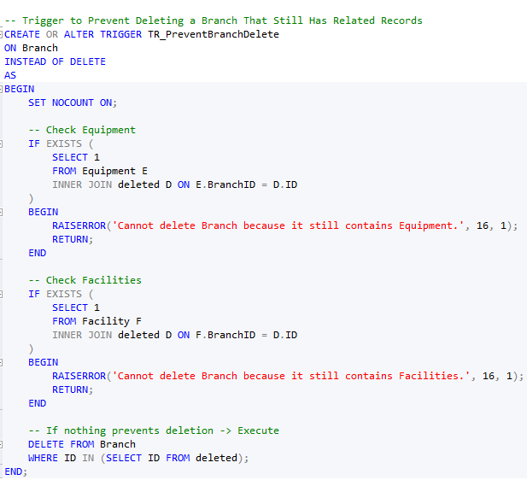
Triggers
3. TR_PreventBranchDelete
Table: Branch
Fires: INSTEAD OF DELETE
Purpose:
Prevents deleting a branch if it is still linked to (Equipment, Facilities).
If any related records still exist, the trigger blocks the deletion and displays an error.

Slide 22
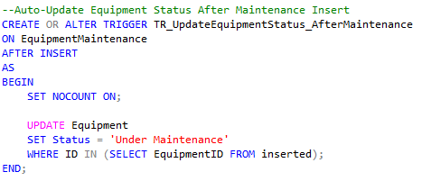
Triggers
4.TR_UpdateEquipmentStatus_AfterMaintenance
Table: EquipmentMaintenance
Fires: AFTER INSERT
Purpose:
Automatically updates the status of the equipment to "Under Maintenance" when a maintenance record is inserted.

Slide 23
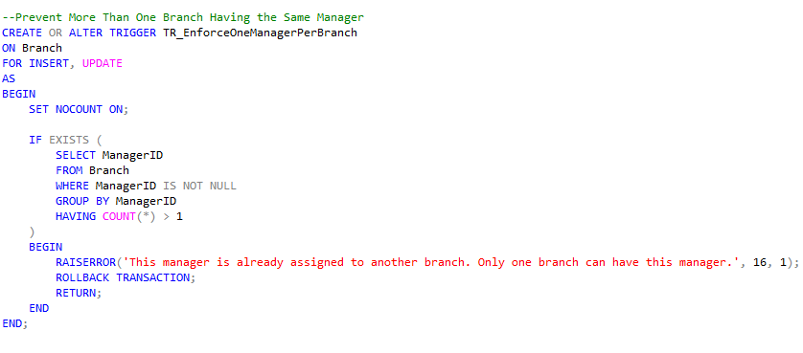
Triggers
5. TR_EnforceOneManagerPerBranch
Table: Branch
Fires: FOR INSERT, UPDATE
Purpose:
Ensures that one manager cannot manage more than one branch.
If a manager ID appears in more than one branch, the trigger rolls back the change and raises an error.

Slide 24
RFM ANALYSIS
RFM (Recency, Frequency, Monetary) is a behavioral model used to evaluate member engagement and value.
Recency: How recently a member renewed.
Frequency: How often they renew.
Monetary: How much they spend.
RFM helps identify high-value members, understand loyalty patterns, and detect early signs of inactivity.

Slide 25








RFM Scoring & Segmentation
Lost Members
no recent renewals
At-Risk Members
declining recency or frequency
Highly Active
consistent renewals
01
03
05
02
04
06
Hibernating
minimal activity
Consistent Members
stable but moderate spenders
Elite Members
highest value, very loyal

Slide 26
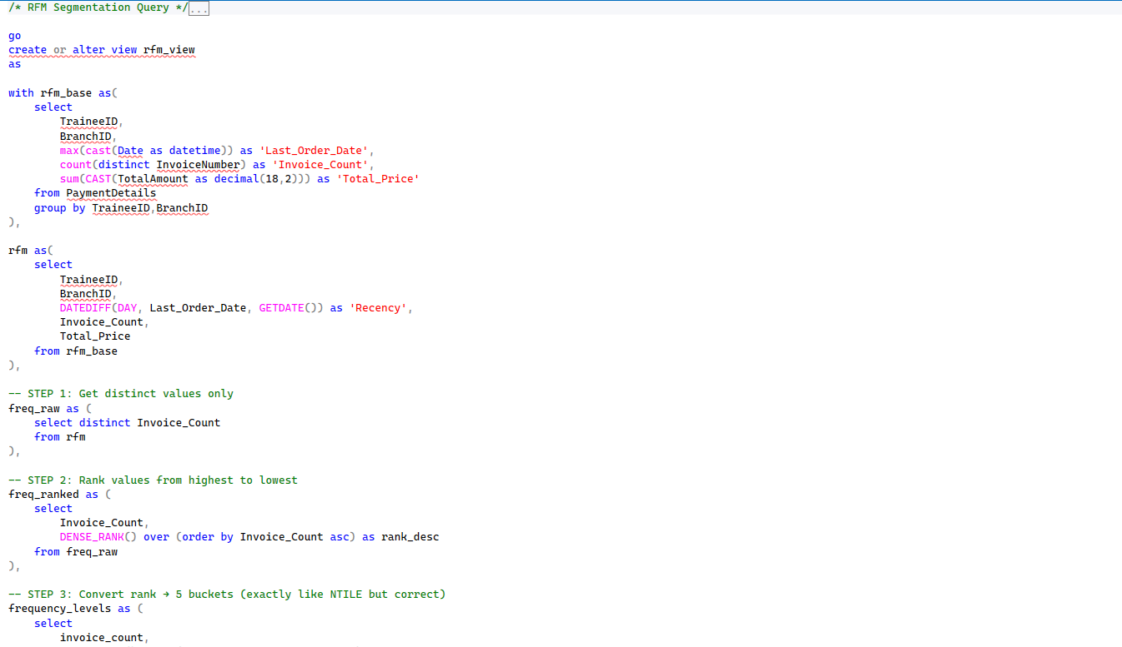
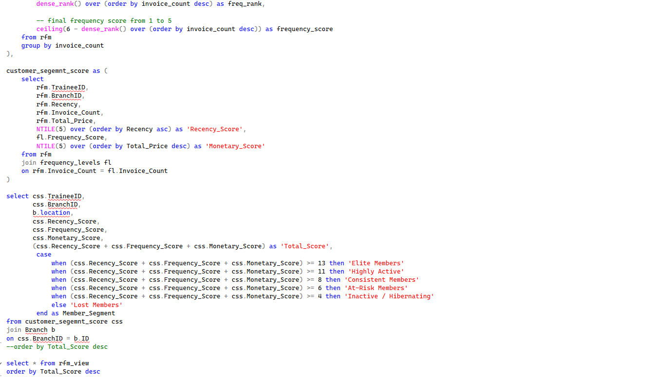


Slide 27
SSRS REPORTS
Developed a collection of SSRS reports powered by custom stored procedures to support operational, financial, and managerial decision-making across different branches of the fitness center.
Each stored procedure extracts and structures branch-specific data, allowing the reports to be fully dynamic and filterable by one or multiple branches.
These reports provide visibility into staff performance, financial trends, operational activities, and customer feedback, helping management monitor the business and make informed decisions.

Slide 28
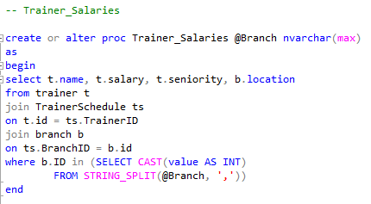
SSRS Stored Procedured
1. Trainer Salaries Report
Shows trainer payroll information, including salary, seniority, and the branch location.
It helps management track trainer distribution and compensation across selected branches.

Slide 29
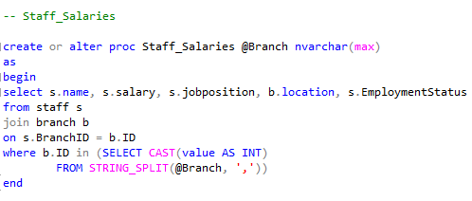
SSRS Stored Procedured
2. Staff Salaries Report
Displays details about staff members such as name, salary, job position, employment status, and the branch they belong to.
Used to monitor HR structure and payroll expenses per branch.

Slide 30
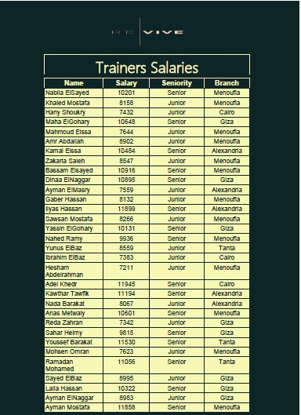
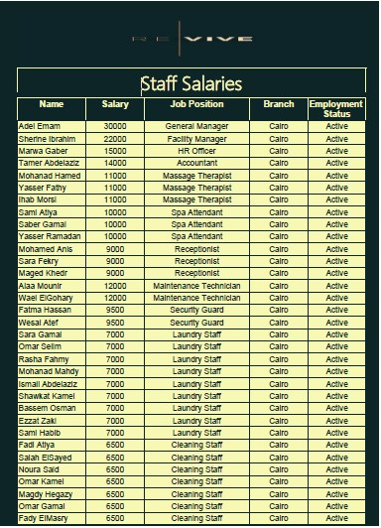
1. Trainer Salaries Report
2. Staff Salaries Report

Slide 31
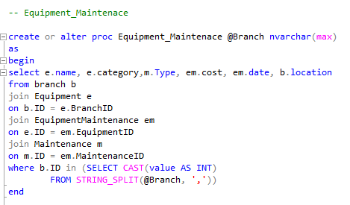
SSRS Stored Procedured
3. Equipment Maintenance Report
Provides a detailed view of equipment maintenance activities, including maintenance type, cost, date, and equipment category.
This report helps branches track maintenance expenses and ensure equipment is properly serviced.

Slide 32
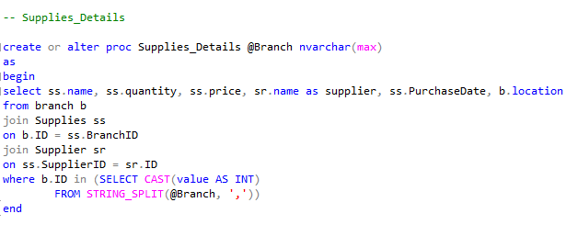
SSRS Stored Procedured
4. Supplies Details Report
Shows all supplies purchased by each branch, including quantity, price, supplier name, purchase date, and total spending.
Useful for monitoring inventory, purchasing patterns, and supplier relationships.

Slide 33
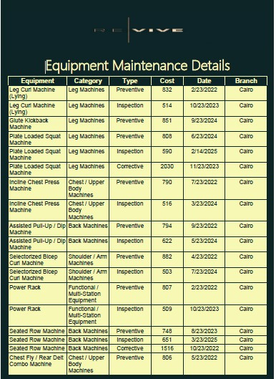
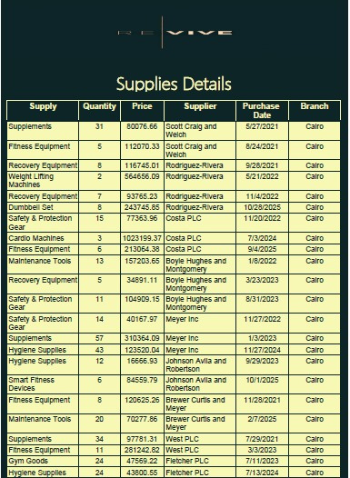
3. Equipment Maintenance Report
4. Supplies Details Report

Slide 34
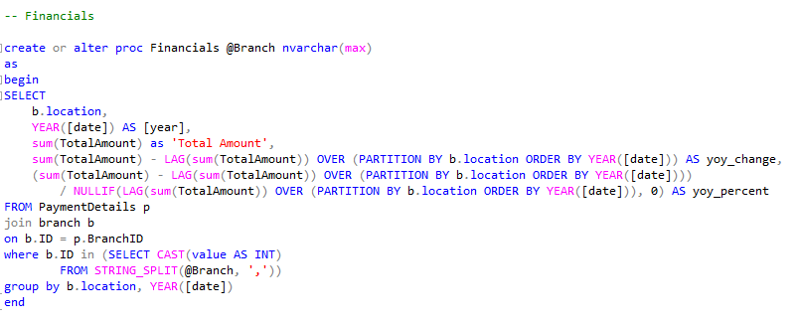
SSRS Stored Procedured
5. Financial Performance Report
Summarizes yearly revenue for each branch, including:
Total amount collected
Year-over-year (YoY) change
YoY percentage growth
This report helps assess financial health and track revenue trends across branches.

Slide 35
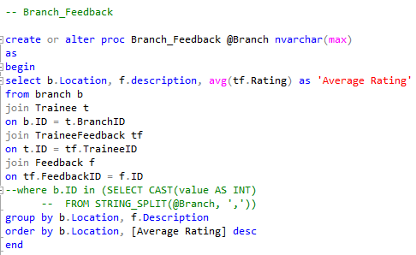
SSRS Stored Procedured
6. Branch Feedback Report
Displays customer feedback categories and the average rating received per branch.
It helps management evaluate customer satisfaction and identify areas needing improvement.

Slide 36
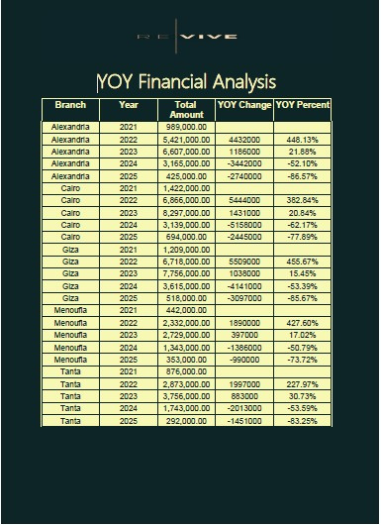
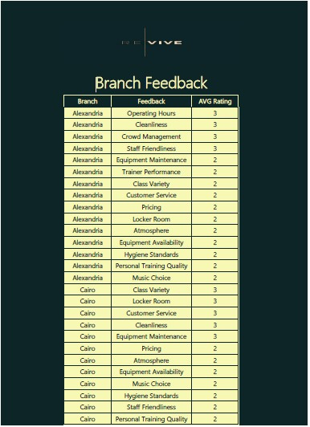
5. Financial Performance Report
6. Branch Feedback Report

Slide 37
POWER BI DASHBOARDS
We built over 20 interactive dashboards using Power BI, incorporating a fully structured data model with fact and dimension tables.
We applied several DAX measures to calculate KPIs, automate calculations, and enhance insights.
The dashboards were designed with a clean and user-friendly layout, using custom visuals, filters, and slicers to improve data exploration.
Overall, the Power BI solution provides clear, accurate, and dynamic insights to support decision-making across all branches.
Power BI

Slide 38
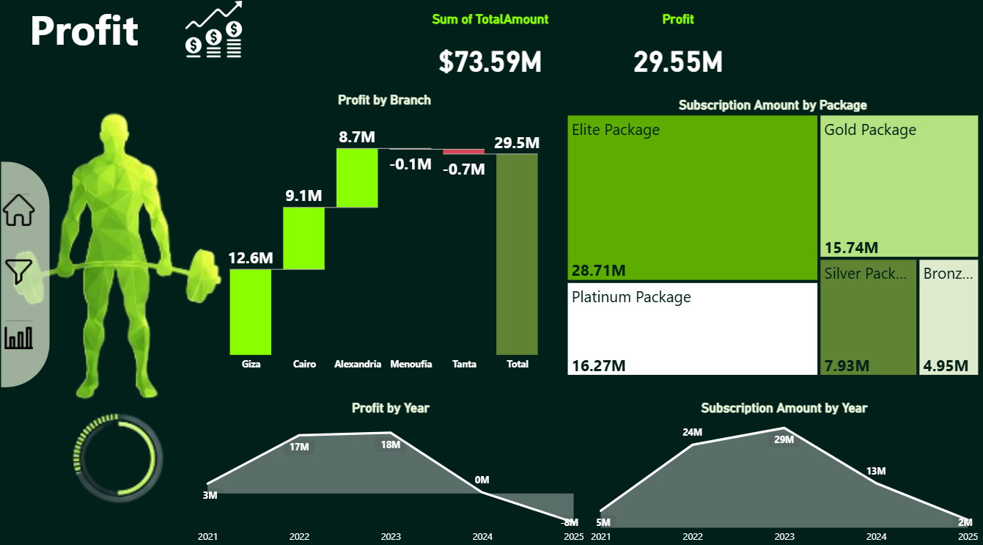
Dashboards
Profit
Top performance branch:
Giza: $28.71M
Loss Center:
Tanta: - 0.7 M
Menofia: - 0.1 M
Total Profit: 29.55 M
2024 was a profitless year
and 2025 ended with -8 M

Slide 39
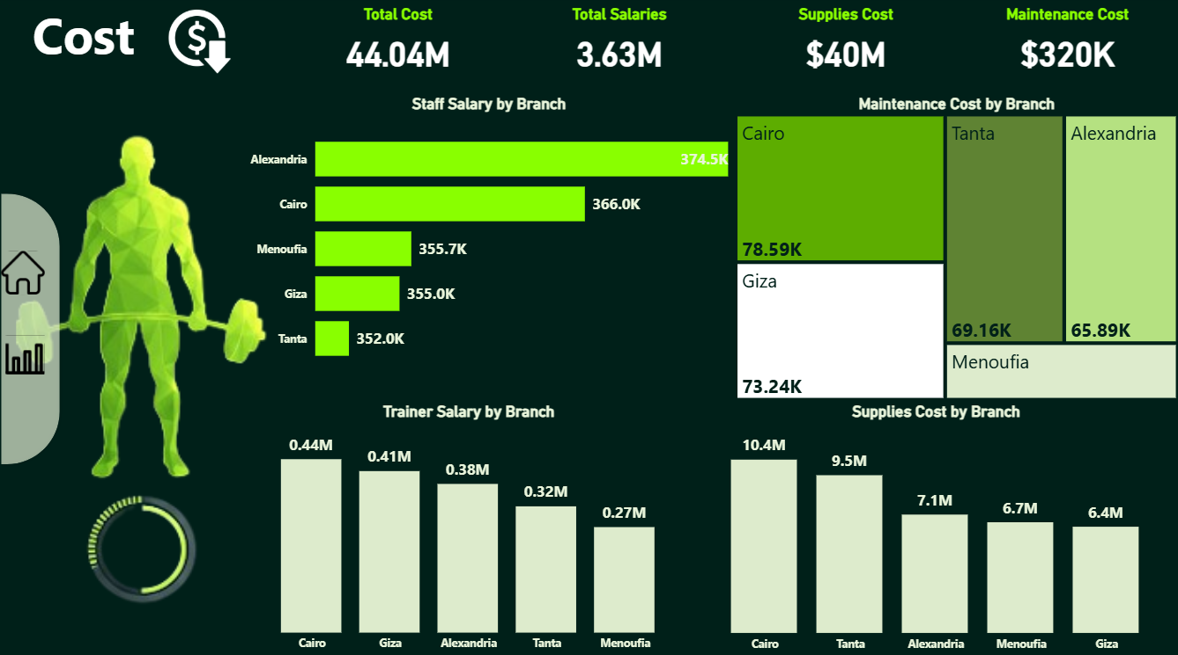
Dashboards
Cost
Top Cost Driver Branch
Cairo is the highest cost driver across most categories
leading in:
Trainer Salaries (0.44M)
Supplies Cost (10.4M)
Maintenance Cost (78.59K)
Highest Staff Salary Branch Alexandria has the highest staff salary cost: 374.5k
Maintenance Costs Are Very Low Relative to Total Cost Maintenance = 320K

Slide 40
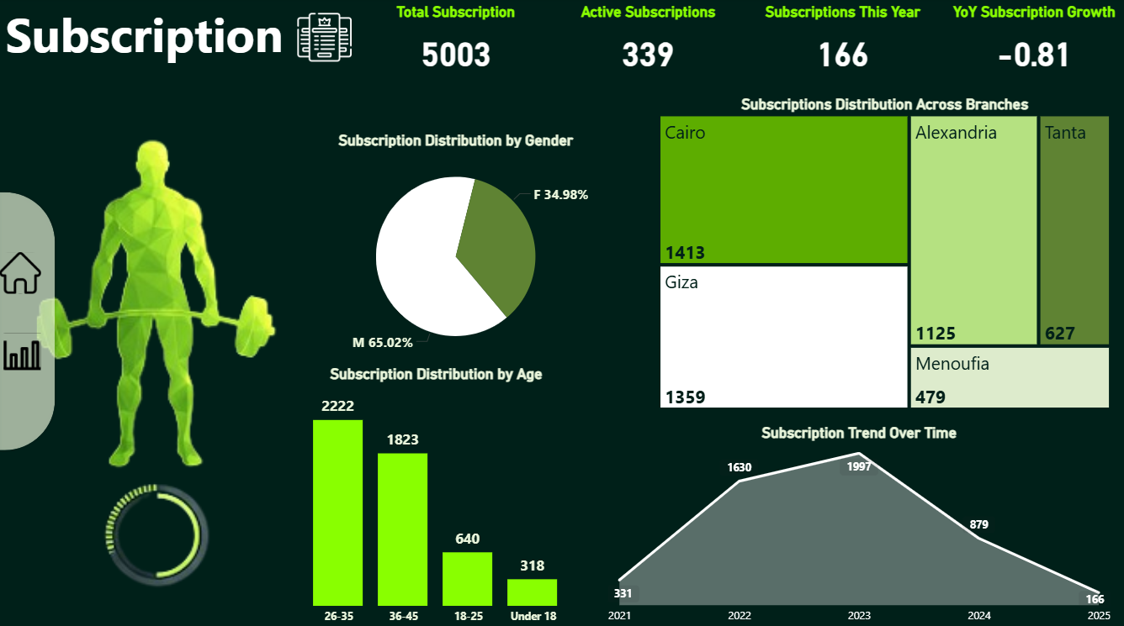
Dashboards
Subscription
Cairo & Giza Are Leading Subscription Hubs
Cairo and Giza together contribute over 55% of total subscriptions
(1413 + 1359 = 2772)
2023 Was the Peak Subscription Year
2023 achieved the highest subscription volume: 1997.
But then:
2024 dropped to 879
2025 dropped to 166

Slide 41
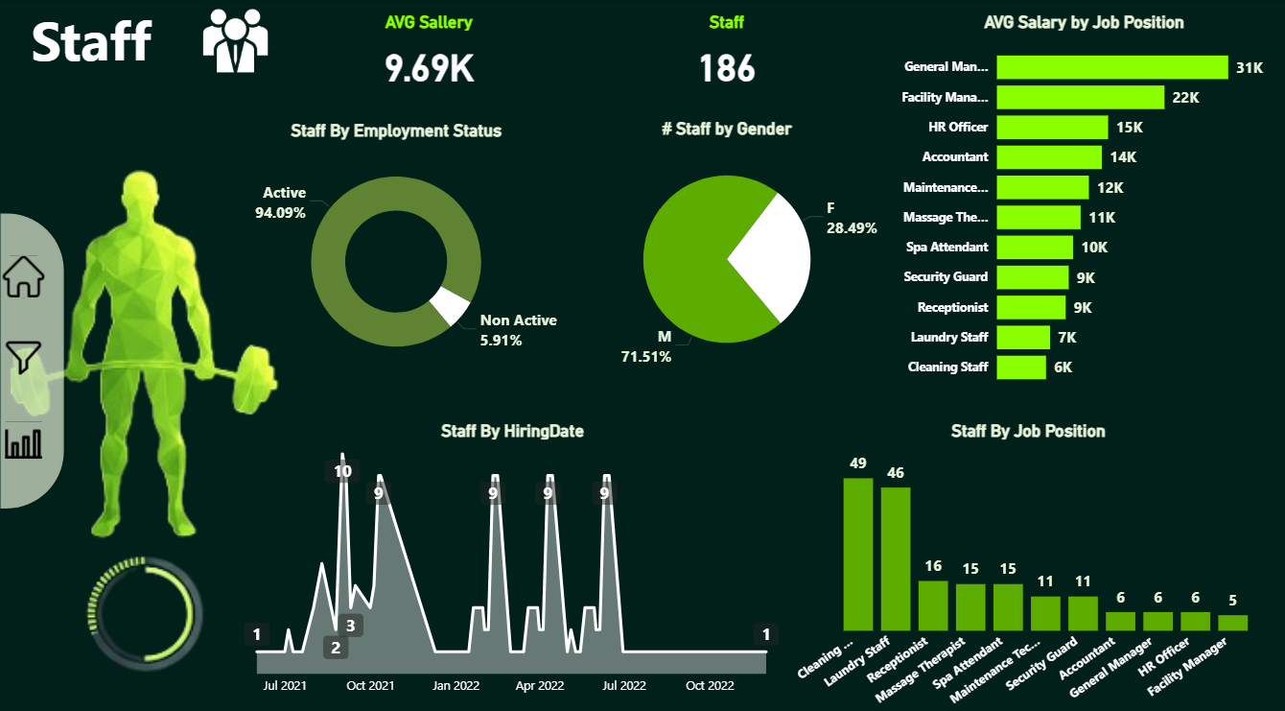
Dashboards
STAFF
Workforce is Highly Active (94% Active Staff)
The organization maintains a very strong operational workforce.
Workforce is Male-Dominated Males = 71.5% Females = 28.5%
General Manager Leads Salary Structure (31K)
Gym Trainers Are the Largest Staff Group
Gym Trainers = 49 employees
Customer Service = 4

Slide 42
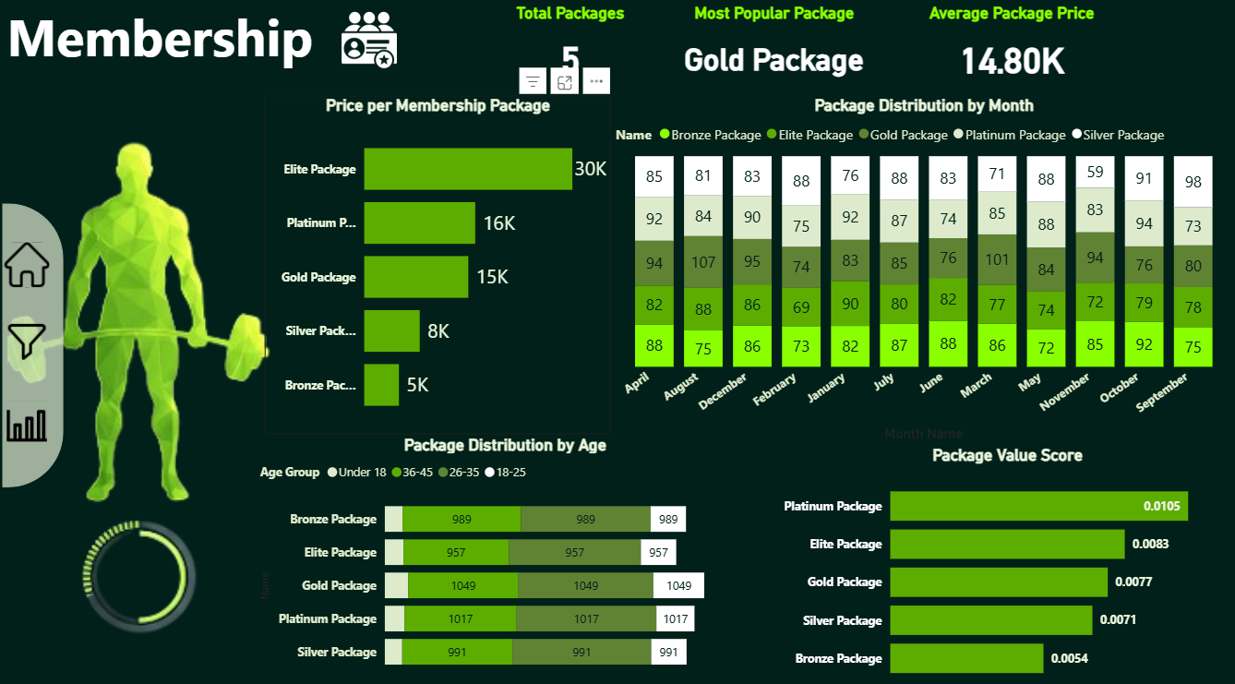
Dashboards
Membership
Gold Package Is the Top Seller Despite Not Being the Highest Value
Age Group 26–40 Is the Core Customer Segment
Across all packages, age 26–40 dominates with counts between 597–1077 per package
Demand Peaks in April, June–July, and October These months consistently show higher package signups

Slide 43

API
Integrated Facebook Graph API to display
profile image dynamically.
Profile image updates automatically
in the Power BI dashboard.
Ensures real-time synchronization with
the Facebook account.

Slide 44
WEBSITE USING FLASK
We have developed a web application for managing a fitness center, including trainee registration, attendance tracking, and payment management.
Used Flask to manage the backend, and used HTML, CSS, Bootstrap for managing the frontend,
The application relies on our database stored on SQL Server.It consists of three pages:
Home page with navigation buttons
Trainee registration page
Attendance registeration page

Slide 45
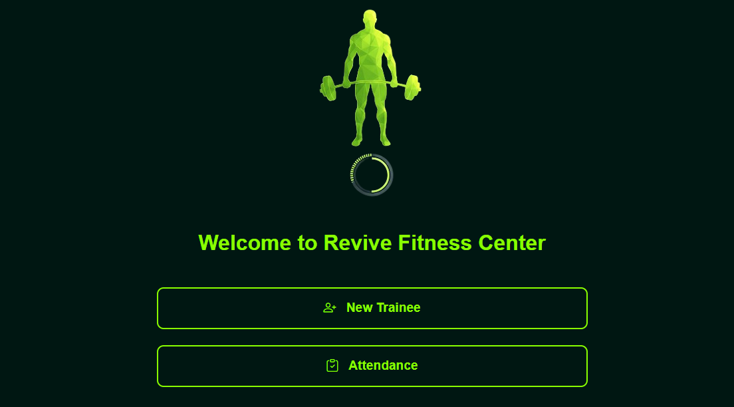

HOME PAGE
It Serves as the central navigation point.
Designed a visually appealing interface with the logo prominently displayed.
Added two main buttons:
New Trainee: Opens trainee registration form.
Attendance: Opens attendance registration page.
Buttons include icons for better user experience.
Layout is responsive, works on different screen sizes.

Slide 46
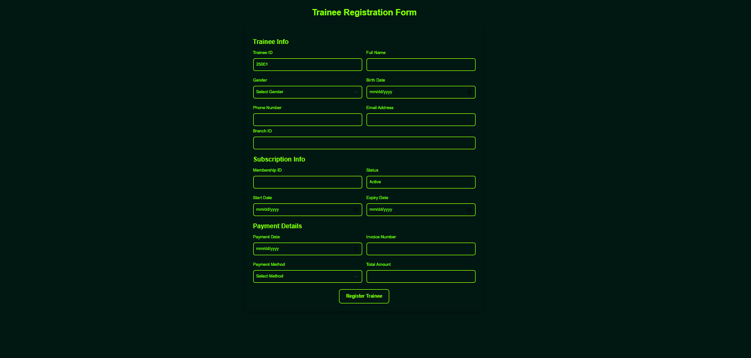
TRAINEE REGISTERATION PAGE
it Registers a new trainee with all necessary information.
Trainee info: ID, name, gender, birth date, phone, email, branch.
Automatic Trainee ID: Fetches the latest ID + 1 from the database.
Membership subscription: Membership ID, status, start and expiry date.
Payment details: Payment date, invoice number (formatted as INV 6000), payment method, total amount.

Slide 47
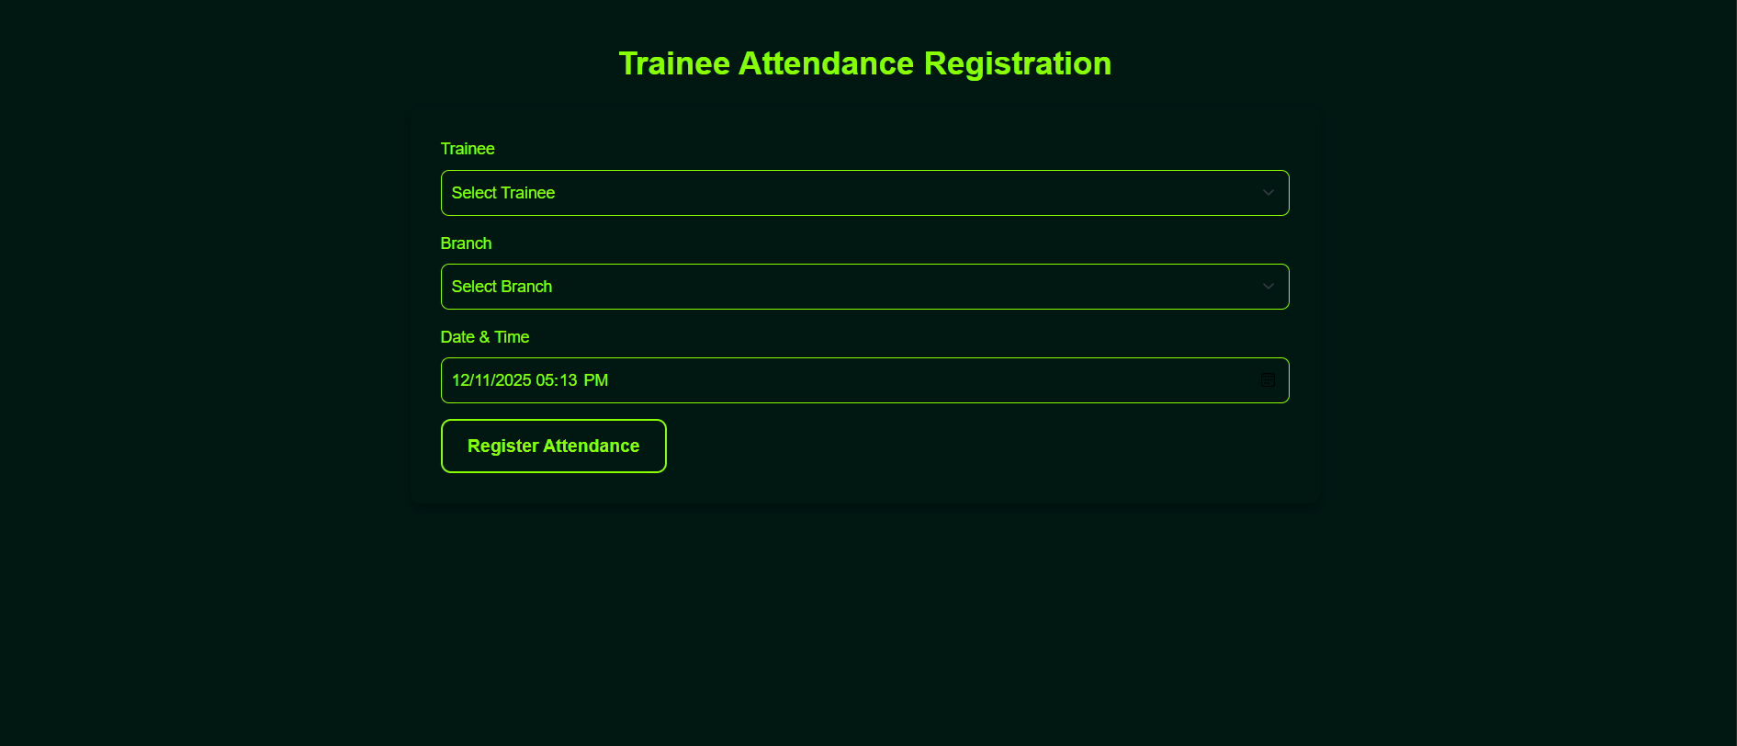
ATTENDANCE REGISTRATION PAGE
it Record daily attendance for trainees.
Select Trainee by name & ID from a drop down list.
Select Branch by location.
Automatically shows current date & time.

Slide 48

THANK YOU

